Slide 1
Cap Store Application

Slide 2
K. Ashritha - 153013 JEE Full Stack - MIPL

Slide 3
MODULES

Slide 4
Modules Assigned
CapStore Home Page
Product Page
WishList
Similar Products
Notes:
Usar para separador de capitulos . Seria bom ter esta versao em vermelho e verde tb..

Slide 5
Module Owned
Cap Store Home Page

Slide 6
Softwares Used
• JDK 10
• Spring Boot 2.x
• My SQL 5.x
• SQL Yog 8.5
• Spring Tool Suite 3.9.x
• Spring Boot Data
• Spring Boot Rest Controller
• JSP – Front-end
• Jenkins – Build Server
• Git - Source Code Repository
• Postman

Slide 7

Cap Store Home Page
Menu which includes all categories.
After Selecting category it will show list of items.
Sorting and selecting items.
A search bar.
All the discounts and promos.
Notes:
O Logo de espadas deve ter mais espaço das pontas abaixo. Sugerir outros tipos de imagens/ telefone, fones.

Slide 8
SCREEN SHOTS

Slide 9
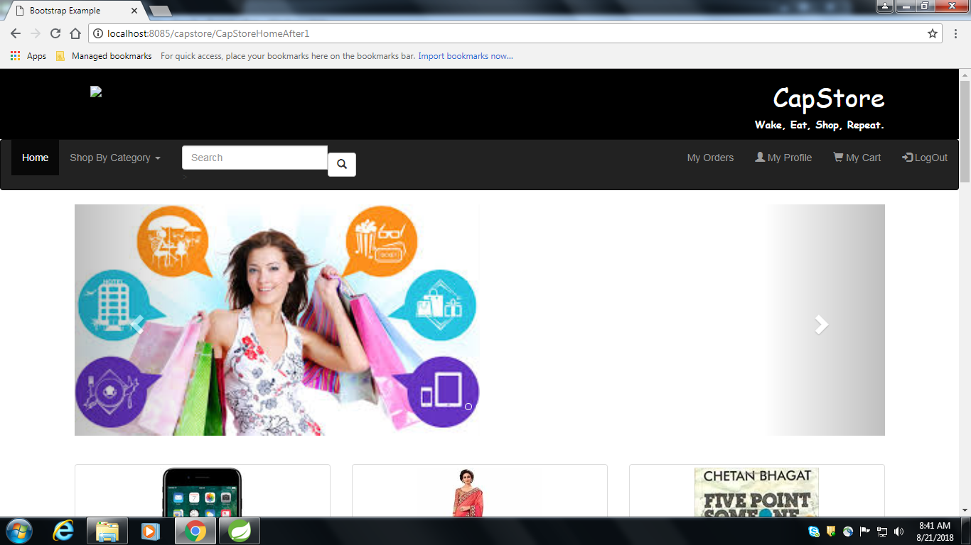

Slide 10
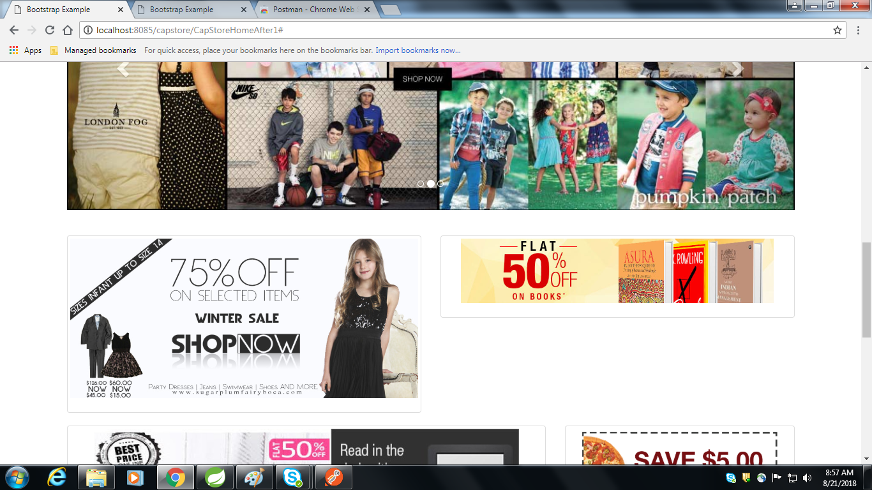

Slide 11
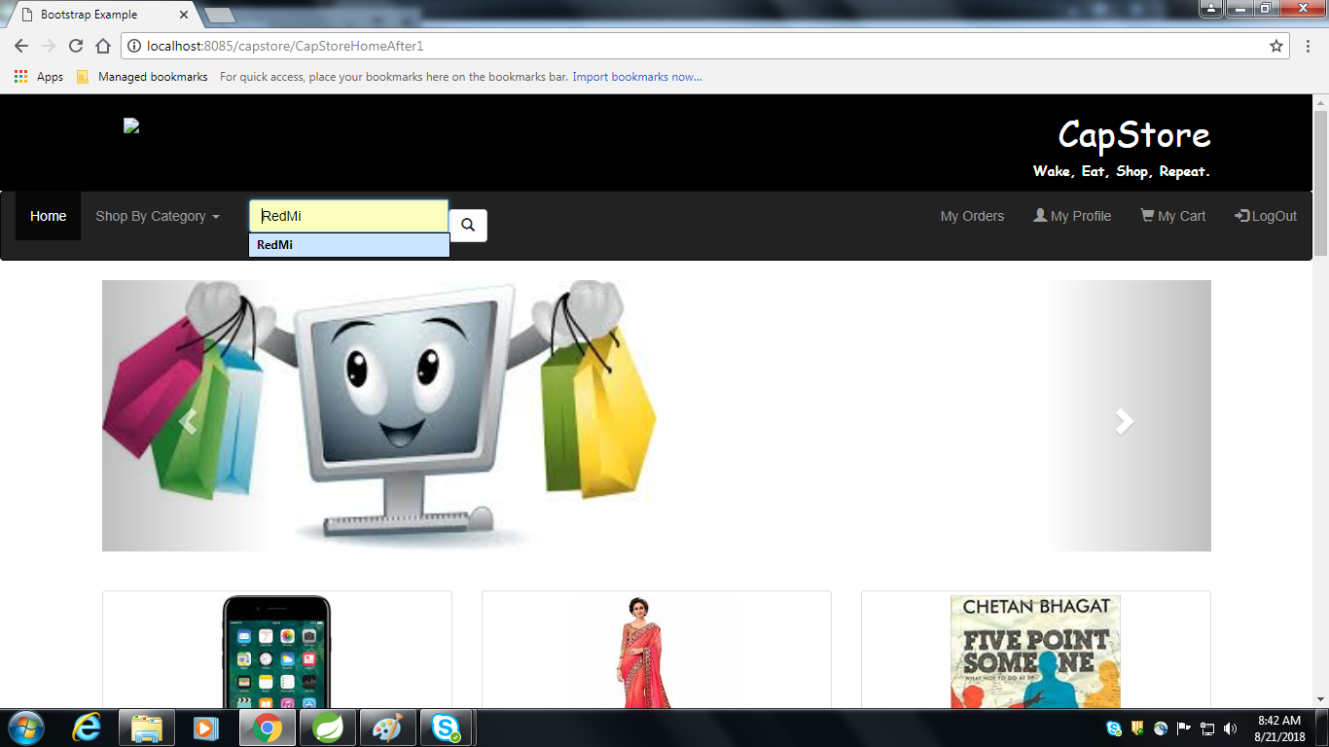

Slide 12
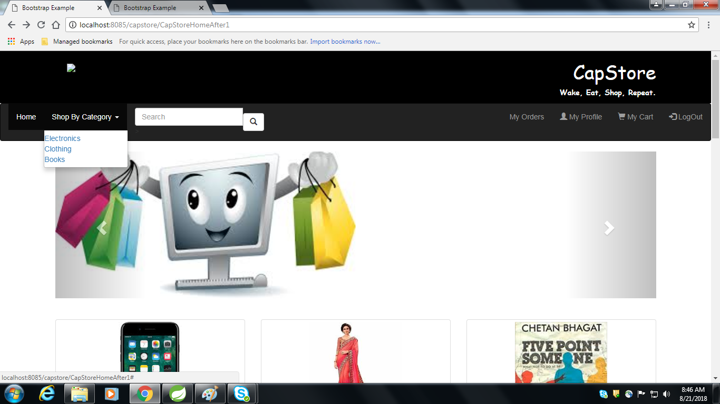

Slide 13
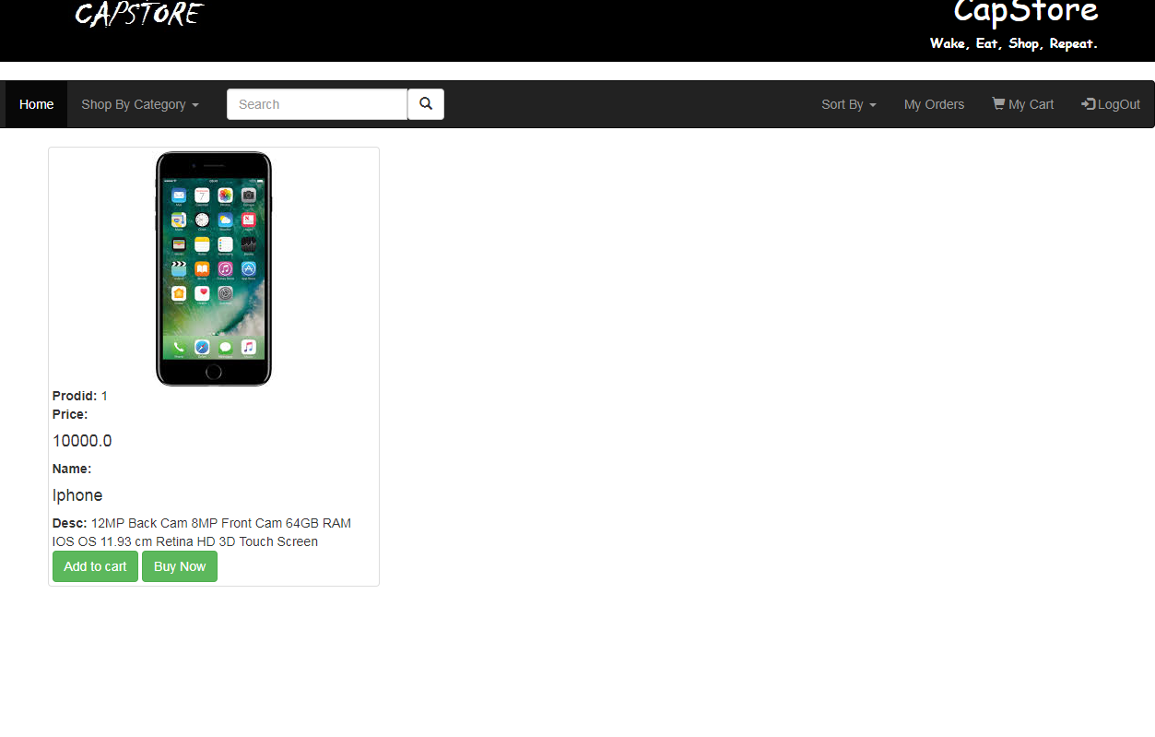

Slide 14
Thank You
Notes:
EVITAR usar o spada branco – tem que ser sempre o colorido.

